Slide 1

Zomato Data Analysis
Using SQL Functionalities

Slide 2
About the data->
This dataset contains 4 relations-
(1)Sales Table-Contains USERID,CREATED_DATE,PRODUCT_ID
(2)Product Table-Contains PRODUCT_ID,PRODUCT_NAME,PRICE
(3)Gold_Users_Signup Table-Contains USER_ID,GOLD_SIGNUP_DATE
(4)Users Table-Contains USER_ID,SIGNUP_DATE

Slide 3
How are we going to analyze the relations?
Let’s make it interesting, we will go question by question and I will answer all the questions with SQL queries.

Slide 4
Starting with the Questions

Slide 5
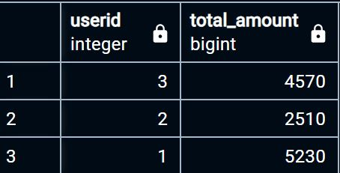
(Q1)What is the total amount each customer spent on Zomato?
The Query that I have used:
select s.userid,sum(p.price) as Total_Amount from sales s
join product p
on s.product_id=p.product_id
group by s.userid
The output I got:

Slide 6
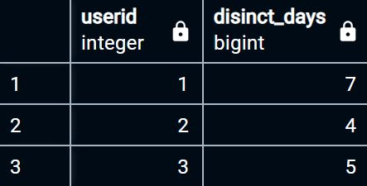
(Q2)How many days has each customer visited Zomato?
The Query that I have used:
Select userid,count(distinct created_date) as disinct_days
from sales
group by userid
The Output I got:

Slide 7
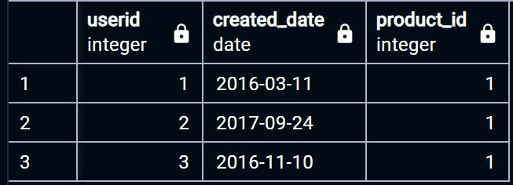
(Q3)What was the first product bought by each of the customer?
The Query that I have used:
select userid,created_date,product_id from
(select *,rank() over(partition by userid order by created_date) as Rank from sales)
where rank=1
The Output I got:

Slide 8
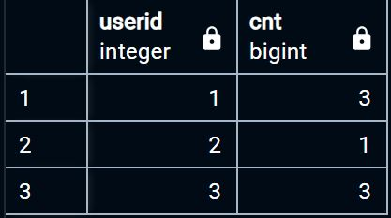
(Q4)What is the most purchased item in the menu and how many times was it purchased by the customer?
The Query that I have used:
select userid,count(product_id) as cnt from sales
where product_id=
(select product_id from sales
group by product_id
order by count(product_id) DESC
LIMIT 1)
group by userid
The output I got:

Slide 9
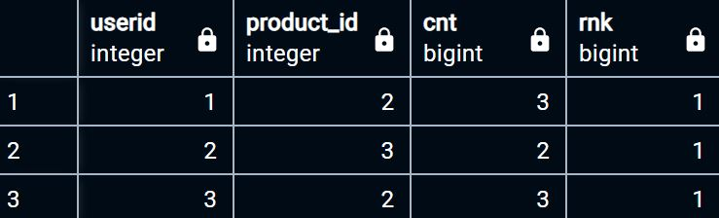
(Q5)Which item was the most popular among the customers?
The Query that I have used:
select * from
(select *,rank() over(partition by userid order by cnt desc) as rnk from
(select userid,product_id,count(product_id) as cnt from sales
group by userid,product_id))
where rnk=1
The Output I got:

Slide 10

The End

